Slide 1
Foundations of Modern Software Systems
Module-2, Lecture-6
Instructor: Piyush Goel
N.M.A.M. Institute of Technology

Slide 2
Recap - Lecture - 5

Slide 3
Storage - Fundamentals
Structuring (Modeling) & Querying
Databases
Types
Use-Cases
Object Storage

Slide 4
Storage - Fundamentals - Databases
Relational
MySQL
Oracle
PostgreSQL
Aurora (Amazon)
Non-Relational
Data-Model Driven
“SchemaLess”
SQLite
“Enforced Schema”

Slide 5
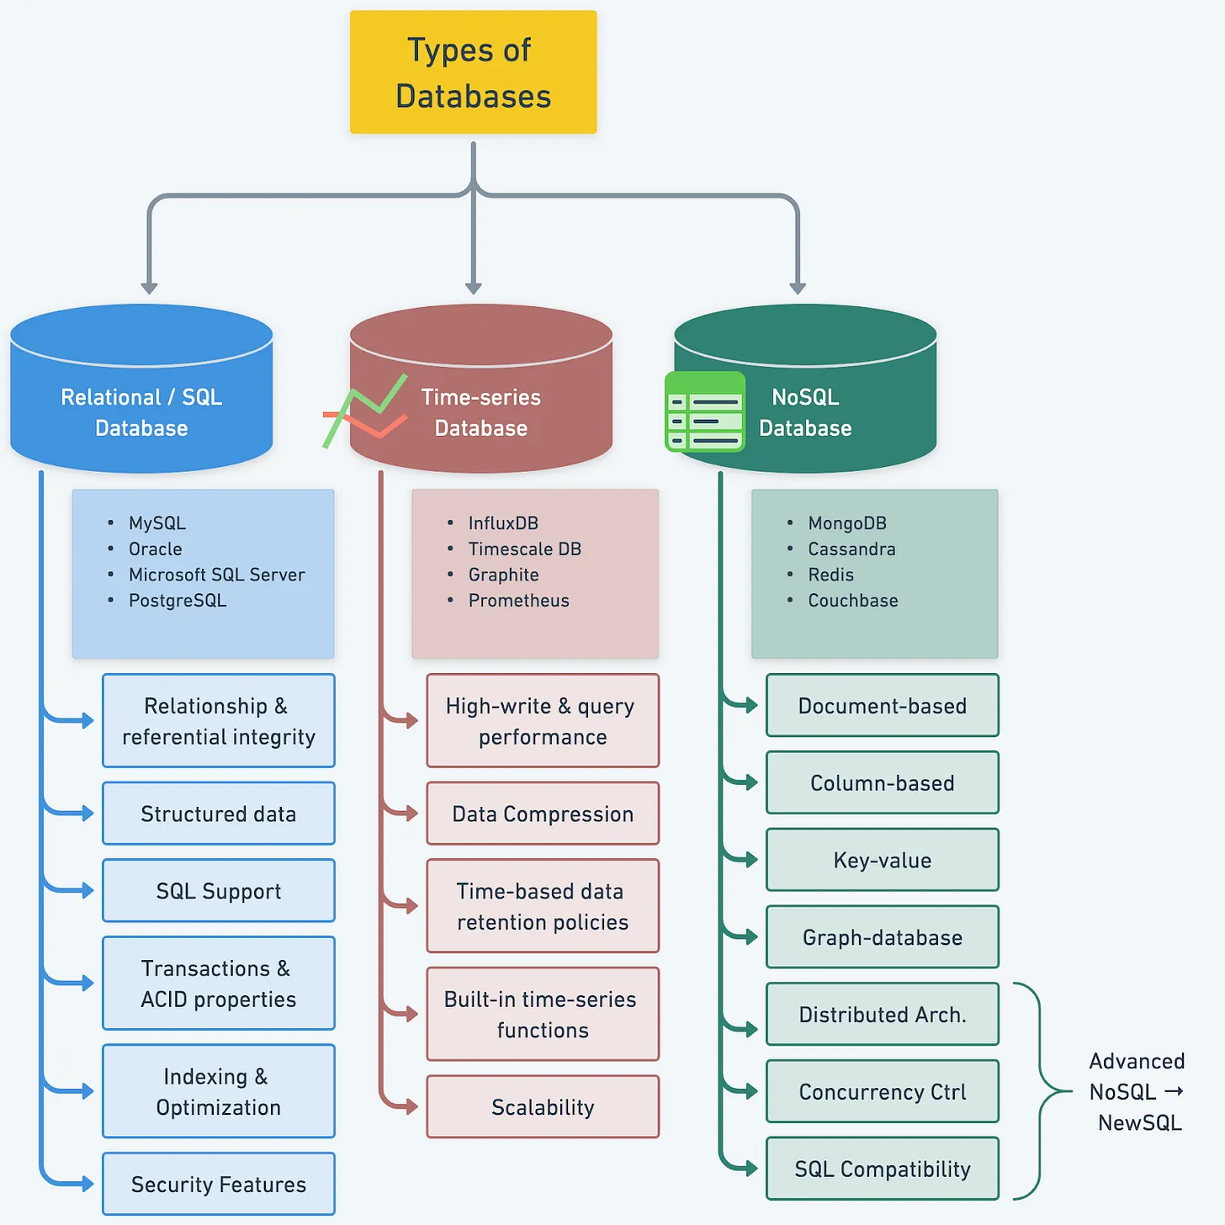
Storage - Fundamentals - Databases
* https://blog.bytebytego.com/p/understanding-database-types

Slide 6
Storage - Fundamentals - Databases - Relational
MySQL for reference
Model Data as a collection of “entities” and their “relationships”
Records identified through Keys (Candidate, Primary)
Interfacing through Structured Query Language (SQL)

Slide 7
Storage - Fundamentals - Databases - Relational
Structured Query Language (SQL)
Data Definition Language (DDL)
Data Manipulation Language (DML)
Data Query Language (DQL)
Examples
Using the Sample data available here - https://github.com/datacharmer/test_db

Slide 8
Storage - Fundamentals - Databases - Relational
Query Processing

Slide 9
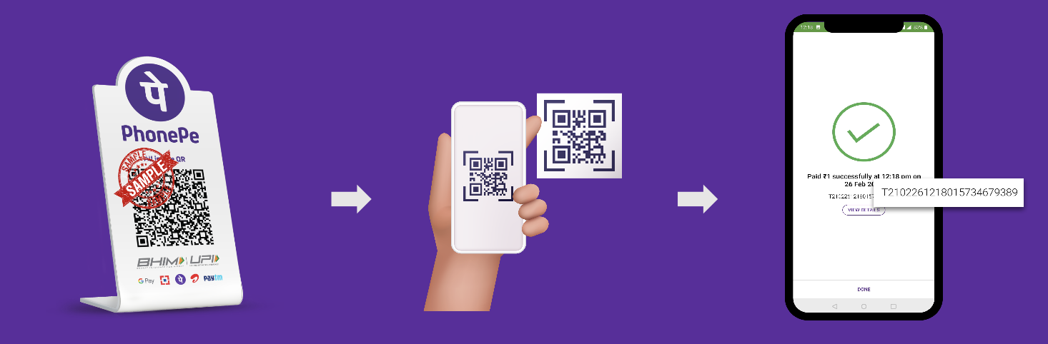
Storage - Fundamentals - Databases - Relational
How does money move from one account to another?

Slide 10
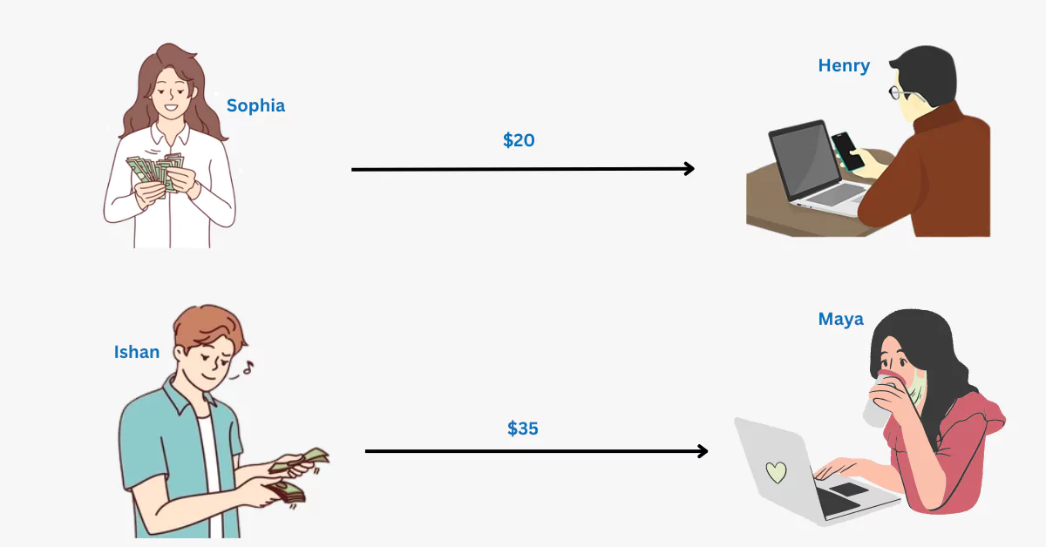
Storage - Fundamentals - Databases - Relational
* https://thinkinfi.com/what-are-database-transactions-with-example/

Slide 11
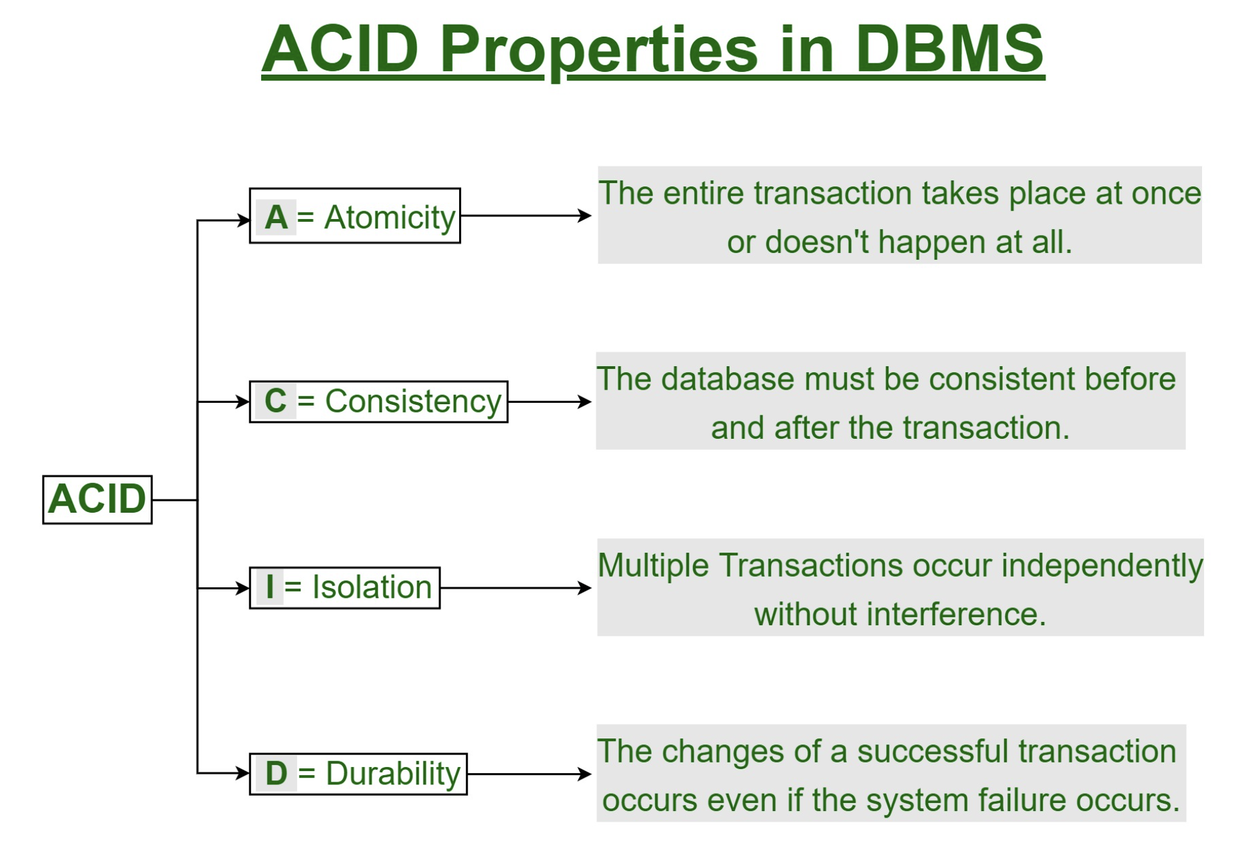
Storage - Fundamentals - Databases - Relational
Transactions - ACID
Atomicity
Consistency
Isolation
Durability

Slide 12
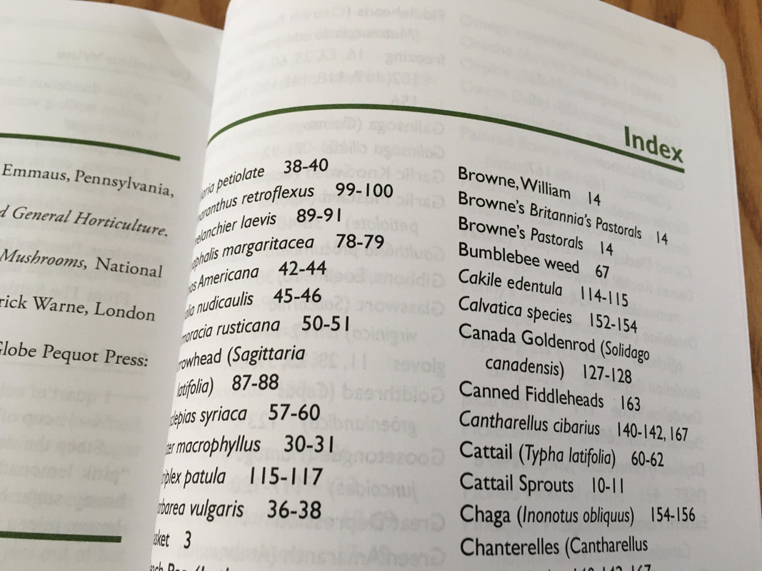
Storage - Fundamentals - Databases - Relational
Indexes

Slide 13
Lecture - 6

Slide 14
Storage - Fundamentals
Structuring (Modeling) & Querying
Databases
Types
Use-Cases
Object Storage

Slide 15
Storage - Fundamentals - Databases - Non-Relational
Non-Relational Data Models
https://blog.bytebytego.com/p/understanding-database-types
Document - MongoDB
Key-Value - Redis
Time Series - InfluxDB
Graph - Neo4j

Slide 16
Storage - Fundamentals - Databases - Key-Value
Key-Value (Redis)
Model data as simple key-value pairs.
Values
Strings
Complex Structures
https://www.youtube.com/watch?v=G1rOthIU-uo&ab_channel=Fireshi
https://redis.io/docs/about/users/

Slide 17
Storage - Fundamentals - Databases - Key-Value
Time Series (InfluxDB)
Model data as a values along a time dimension.
https://www.youtube.com/watch?v=b5GAvYu8Vzc&ab_channel=Timescale
InfluxDB
Tutorial: https://github.com/influxdata/influxdb

Slide 18
Storage - Fundamentals - Databases - Key-Value
Graph Databases
Model Object Graphs
Knowledge Graphs (Recommendation)
Social Graphs (Instagram, Facebook, Twitter)
Neo4j
AWS Neptune

Slide 19
Object Storage

Slide 20
Storage - Fundamentals - Object Storage
Model data as a self-contained objects (binary) with basic metadata.
No tree/folder structure like a file-system
Text, Audio, Video, Images, Back-up images, et al.
https://www.youtube.com/watch?v=ZfTOQJlLsAs&t=1s&ab_channel=IBMTechnology
AWS Simple Storage Service (S3) Intro
https://aws.amazon.com/blogs/aws/amazon-s3s-15th-birthday-it-is-still-day-1-after-5475-days-100-trillion-objects/
Google Cloud Storage
https://www.youtube.com/watch?v=VDBhvexAj8I&ab_channel=GoogleCloudTech

Slide 21
Questions

